Slide 1














STUDENT
REGISTRATION
SYSTEM
PROJECT BY A GROUP OF CLASS 10

Slide 2

WHAT IS THIS PROJECT?
Student Registration System
Software using QBASIC
Modular programming
File Handling
Prototype to show the use of qbasic

Slide 3


KEY FEATURES
01
02
03
Adding records of the student
SEARCHING RECORDS WITH STUDENT'S NAME
UPDATING THE INFORMATION OF STUDENTS
04
05
CAN BE ADDED
AS PER THE
NEED
DELETING THE RECORDS OF STUDENTS
VIEWING ALL RECORDS AT ONCE

Slide 4
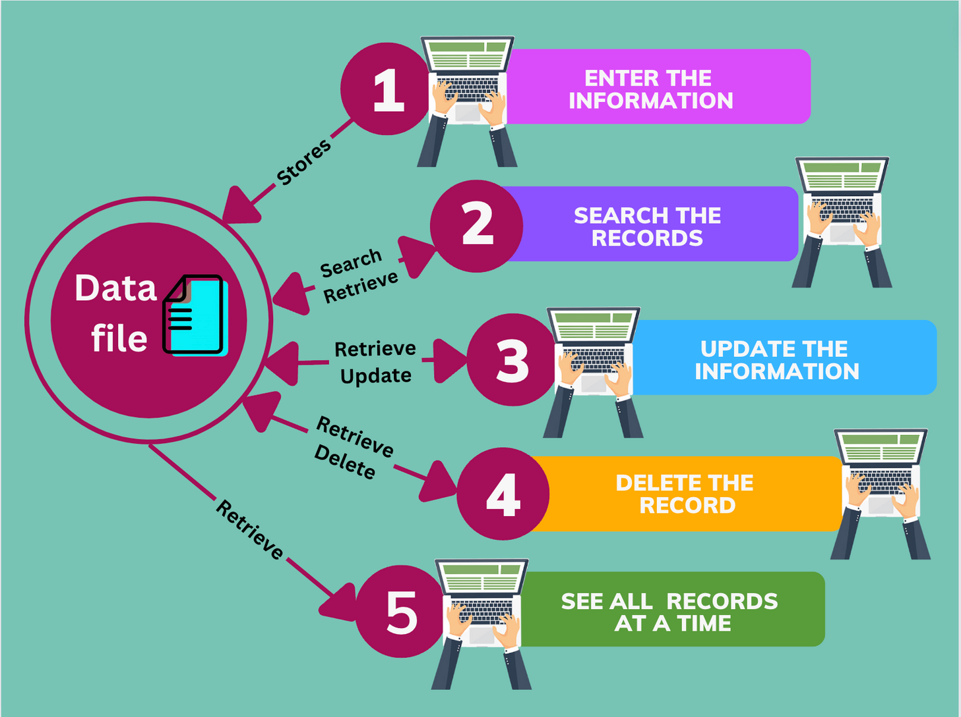
HOW IT WORKS?
VIEW ALL RECORDS
AT A TIME

Slide 5


OBJECTIVES
SCHOOL PROJECT
SOFTWARE WITH A LANGUAGE
We want to understand as well as show you all that QBASIC can also be used in making software. We can make simple softwares that we can use in our own computer to make the task easy.
We made this system as our school project. Our subject teacher assigned us to make a software using qbasic and we chose student registration system as our project.

Slide 6
LET'S SEE THE SOFTWARE

